Slide 1

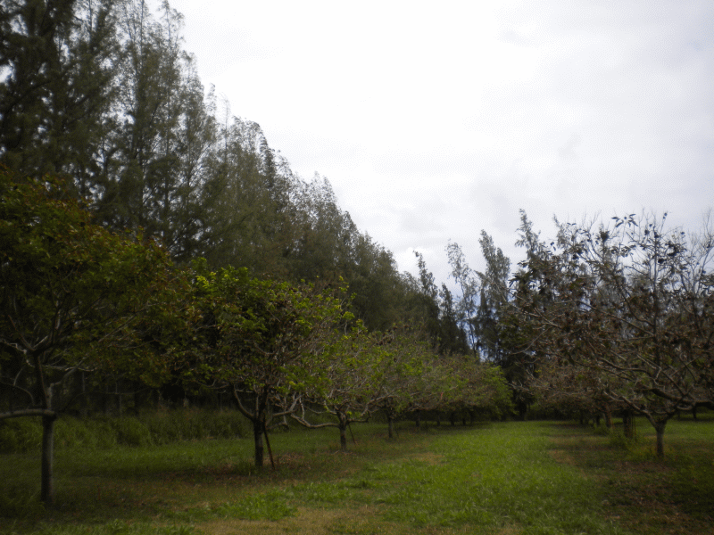
Windbreak Basics
Prepared by:
L. Robert Barber, Frank Cruz, Ilene Iriarte, Mark Acosta, Joe Tuquero, and Christine Laurent
Guam Cooperative Extension Service

Slide 2
What is a Windbreak?
Single or multiple rows of plants strategically placed to protect an area from winds that may hinder crop & livestock production, including potential damage to structures
Filters and slows the wind that enters the area
Also known as shelterbelts
Can consist of living vegetation and/or structural wind barriers from non-living materials

Slide 3
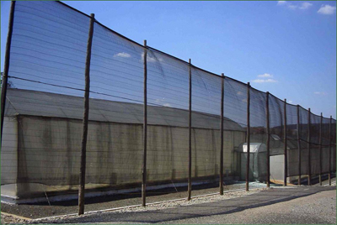
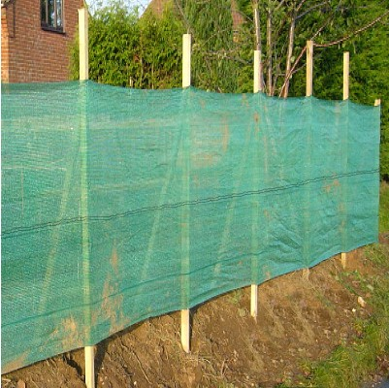
Structural Windbreak
http://www.crec.ifas.ufl.edu/extension/windbreaks/florida/examples/nursery.shtml
http://premiernetting.co.uk/catalog/knitted-windbreak-netting-fence-p-421.html

Slide 4
What is a Multipurpose Windbreak?
Provides multiple functions and/or products, in addition to wind protection
Fruits
Timber (lumber, arts and crafts, and fuel)
Animal fodder
Wildlife habitat
Medicine
Mulch and organic matter

Slide 5
Protecting Against the Wind
Why do we want to protect our crops from wind?
Wind stresses (physical damage, leaf burn) plants
Winds remove moisture
Erodes soil
Carries salt

Slide 6
Protecting Against the Wind
Why do we want to protect our structures from wind?
Winds can damage structures
Homes
Barns
Storages
Fences
Trellis
Etc.

Slide 7
Additional Benefits
Improvement of crop/pasture quality
Conserves moisture
Reduce erosion
Intercepts potential salt spray, dust, and chemical drift
Can limit damage from storms
Reduce noise levels
Increase on-site resources (mulch, organic matter, wood products, plant material)
Reduce unpleasant odors
Provide as visual screens/living barrier

Slide 8
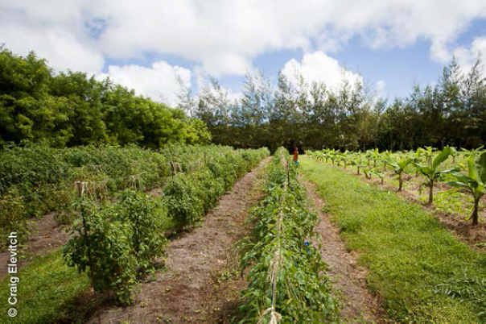
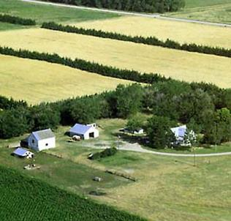
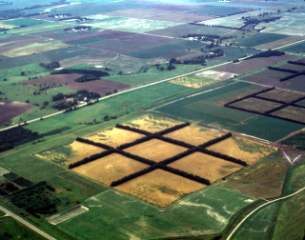
Field Windbreaks
Notes:
Different conservation needs require different windbreak designs.

Slide 9
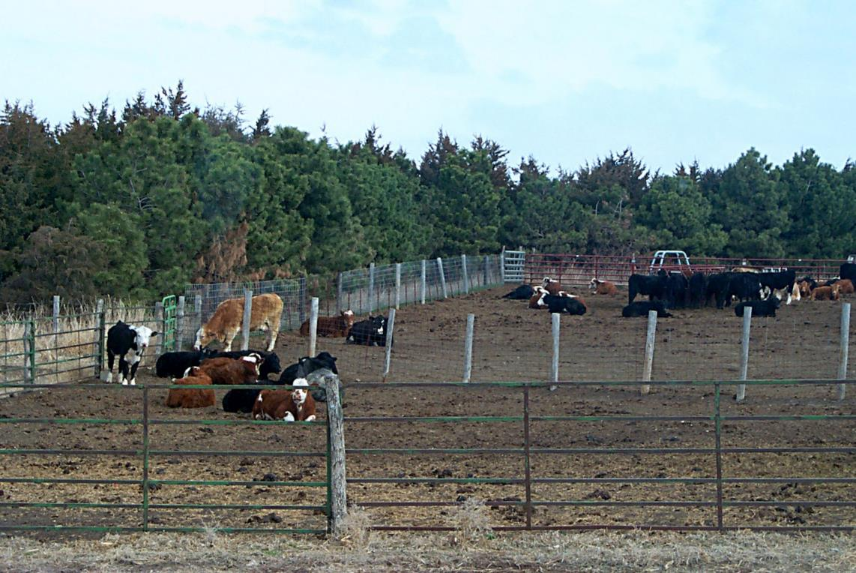
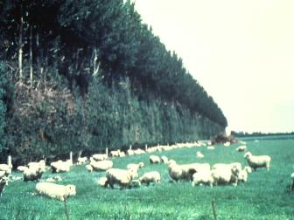
Livestock Windbreaks

Slide 10
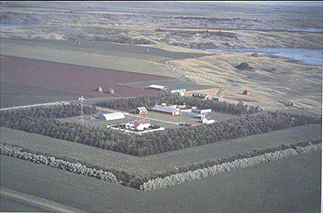
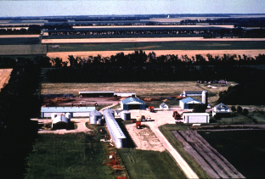
Farmstead (Structure) Windbreaks

Slide 11
Disadvantages of Windbreaks
If managed incorrectly can create concentrated wind tunnels
Takes up space
Can cause competition with crops (extended roots in fields, nutrients, water, over-shading)
If installed improperly can interfere with:
Overhead and Underground utility infrastructure
View planes
Neighbors’ borders

Slide 12
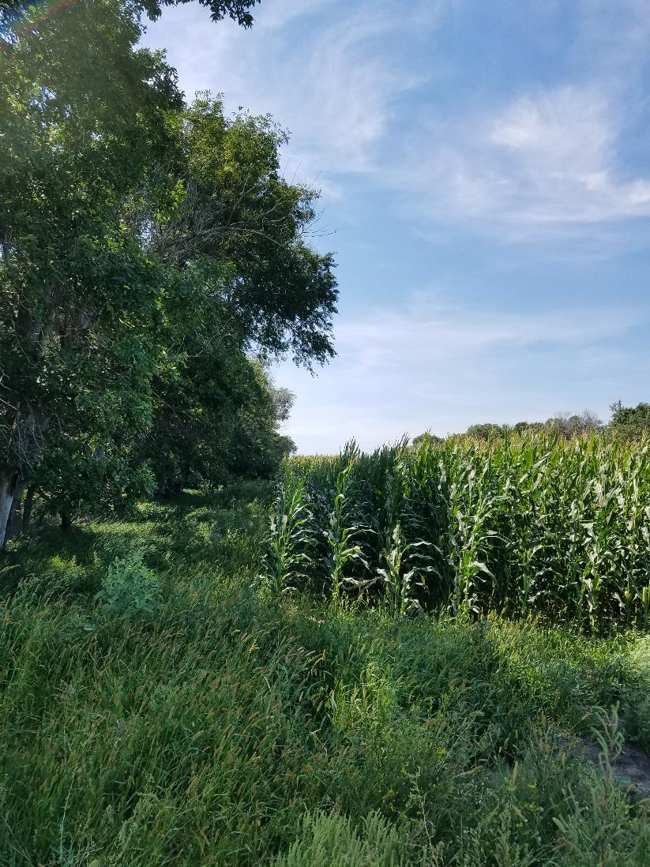
Disadvantages of Windbreaks
Over-shading
Competition
Reduction of Crop Space
Notes:
Corn field near Bismarck, ND

Slide 13
Windbreak Design Considerations
Planning your windbreak is necessary to optimize it’s effectiveness and avoid future problems
Key physical factors:
Species
Spacing
Orientation
Height
Length
Density
Continuity

Slide 14
Species
Selected Species should be:
Wind-strong
Long-Lived
Adapted to site conditions
Species can also be selected to provide:
Timber/Fiber
Food
Fodder
Floral Production
Wildlife Habitat
Medicinal uses

Slide 15
Species
Understand Growth Characteristics of desired species for proper spacing and proper densities
Invasiveness
Potential of competition with field crops
How fast they grow
Canopy widths
Average heights
Deciduous, Semi-deciduous or Evergreen
Type of maintenance required for specific species
Pruning
Irrigation
Fertilizing
Weeding
Species can also be selected to provide:
Timber/Fiber
Food
Fodder
Floral Production
Wildlife Habitat
Medicinal uses

Slide 16
Species - Heights
Short Species: 20 feet and under
Calamansi - Noni
Soursop - Lemon china
Surinam Cherry - Pomegranate
Saba/Palau banana - Other Citrus
Medium to Large Species: over 20 feet
Dwarf coconut
Avocado
Mango
Breadfruit
Tamarind

Slide 17
Spacing - Recommendations
Fruit Trees: | Windbreak: | Orchard:
Calamansi | 5-8 feet | 8-10 feet
Soursop | 5-8 feet | 8-14 feet
Pomegranate | 5-8 feet | 8-14 feet
Surinam Cherry | 8-10 feet | 10-15 feet
Noni | 6-10 feet | 10-15 feet
Lemon China | 6-10 feet | 8-14 feet
Avocado | 12-18 feet | 20-40 feet
Saba Banana | 8-14 feet | 12-18 feet
Dwarf Coconut | 10-12 feet | 15-20 feet
Breadfruit | 12-16 feet | 15-40 feet
Mango | 10-16 feet | 15-40 feet
Tamarind | 8-15 feet | 15-30 feet

Slide 18
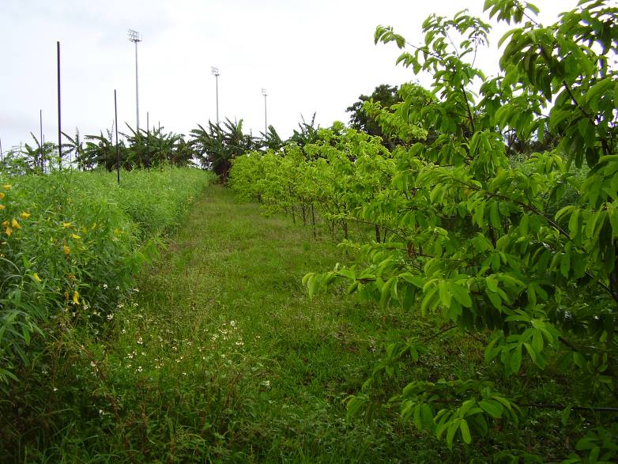
Species
Gågu
Banana and Soursop

Slide 19
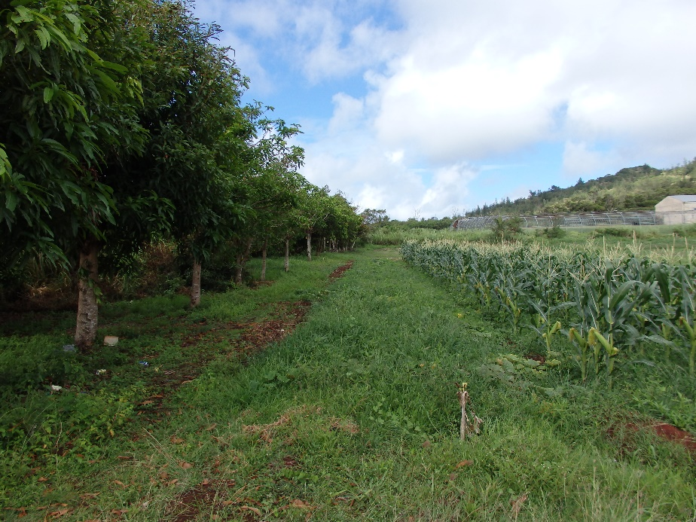
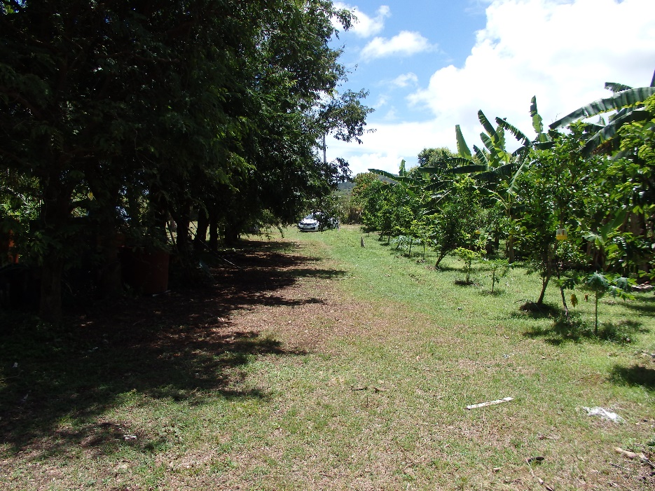
Species
Mango
Tamarind

Slide 20
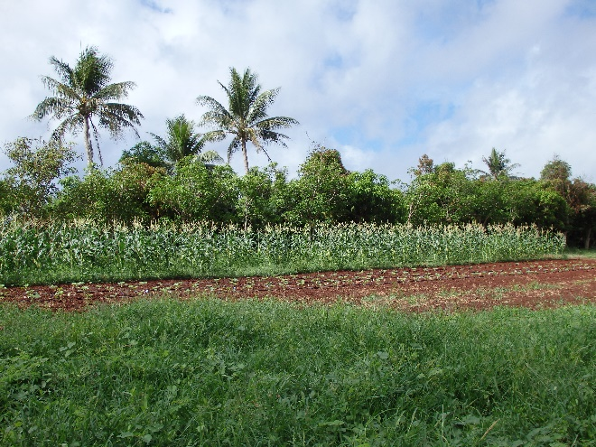
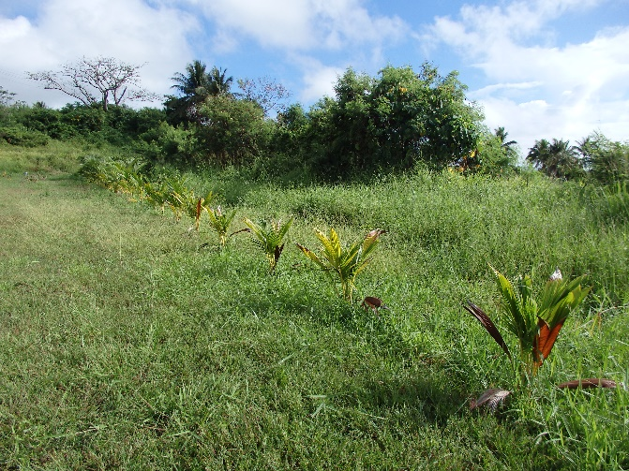
Species
Coconut and Mango
Coconut

Slide 21
Staggered spacing filters and slows the wind
WIND
DIRECTION

Slide 22
Even spacing creates gaps that can accelerate wind

Slide 23
Orientation
Essential for effective protection
Perpendicular to the prevailing wind direction (at the least)
On Guam and most Pacific islands, most fields require protection from all directions as trade winds may shift from all directions throughout the year

Slide 24
Correct Orientation
WIND
DIRECTION

Slide 25
Wrong Orientation
WIND
DIRECTION

Slide 26
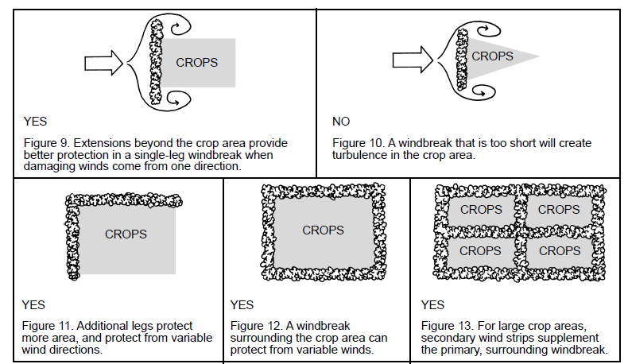
Orientation

Slide 27
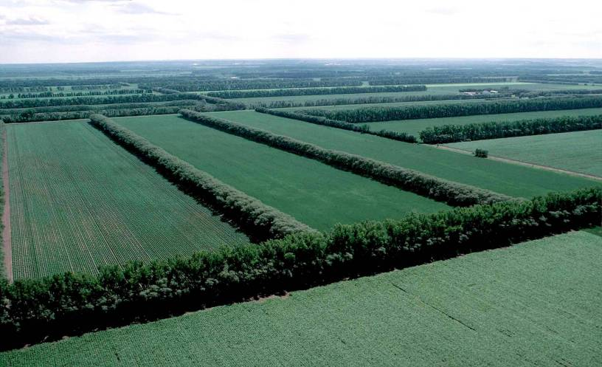
Windbreak Orientation
Troublesome
Wind(s)??
Orient windbreaks perpendicular to troublesome winds
Plan multiple windbreaks for whole field protection
Notes:
The area of protection is greatest when the wind encounters the windbreak at 90 degrees or when it is perpendicular to the windbreak. As the angle of approach decreases the zone of protection decreases.
*Does the predominate wind direction vary through the seasons?
*During which season is wind the biggest problem?
*Plan the windbreak orientation to be as close as possible to the troublesome wind.

Slide 28
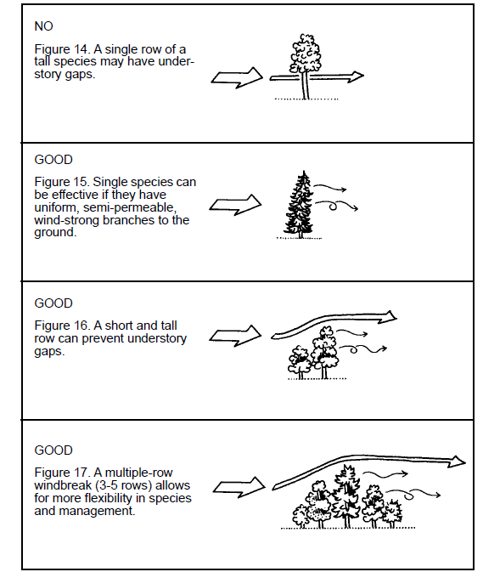
Windbreak Orientation

Slide 29
Single Row Windbreaks
Use only if the species has uniform wind strong branches from the ground up
Limited species, which meet this criteria
High risk of losing entire row
Single row takes up less space

Slide 30
Multiple Row Windbreaks Consist of Two or More Rows
Multiple rows require more land
If multiple species, more harvest opportunities
Greater species selection available
Decreased risk of losing entire investment

Slide 31
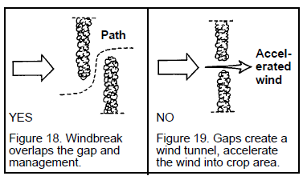
Windbreak Orientation

Slide 32
Windbreak Height
Can reduce wind speed for a distance of 10 times their height
Large fields, should have secondary wind strips
Small areas can use smaller and lower growing species
Height of windbreak should be determined by the expected height of your crop
Windbreaks ideally should be twice as tall as your crops

Slide 33
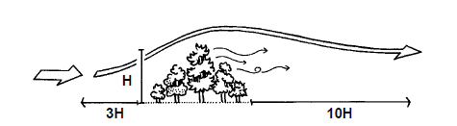
Windbreak Height
Windbreak protects crop area to about 10 times the height of the windbreak

Slide 34
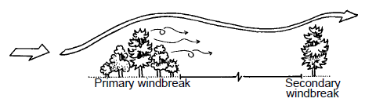
Windbreak Height
If crop area is longer than 10 times the height of the windbreak, add secondary windbreaks

Slide 35
Windbreak Length
Prevent winds from coming around the ends
Additional lengths past the protected area
Additional legs that prevent wind from whipping around
Length of windbreaks should extend about five times the height (5H) of the windbreak
For large crop areas:
secondary wind strips should be used to supplement the surrounding windbreaks

Slide 36
Windbreak Length

Slide 37
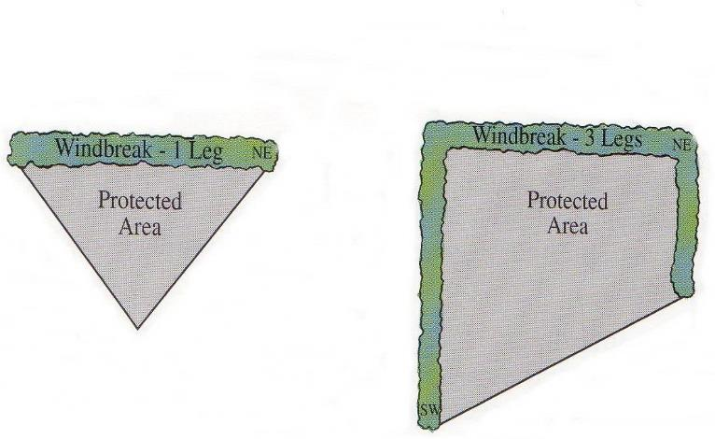
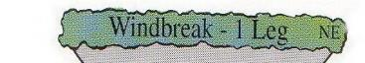
Windbreak Length and Orientation
Notes:
When troublesome winds will cross windbreaks at a significant angle. Use the wind angle calculator provided in NRCS PIA Veg. Spec. located in the Planner’s area of the IR template for Windbreak/Shelterbelt Establishment Implementation.

Slide 38
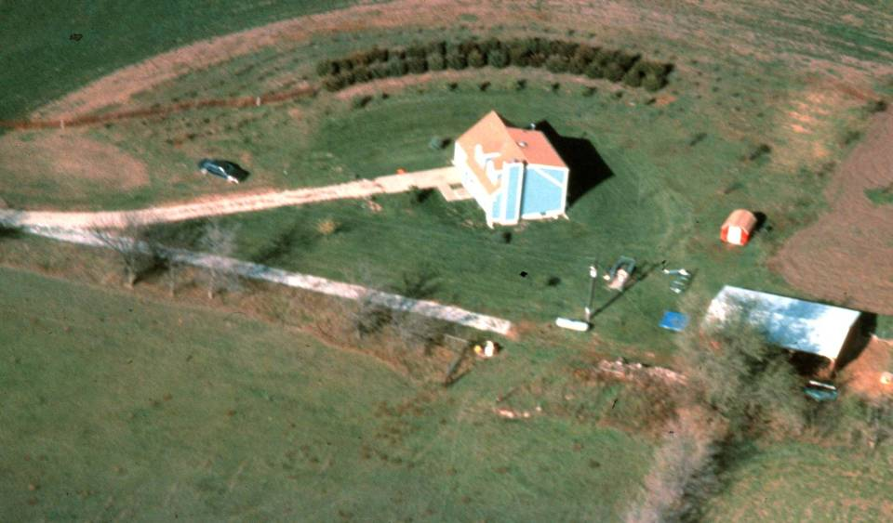


Windbreak Length and Orientation
Notes:
This example shows an original windbreak that was too sort to provide adequate protection to the house and living space. The windbreak was later extended on both ends.

Slide 39
Windbreak Density Should slow the wind, not completely block it
Crops
40-60% density
Noise Reduction, Structures & Livestock
At least 65% density
Air Quality (foul odors, dust, chemical drift)
At least 50-65% density

Slide 40
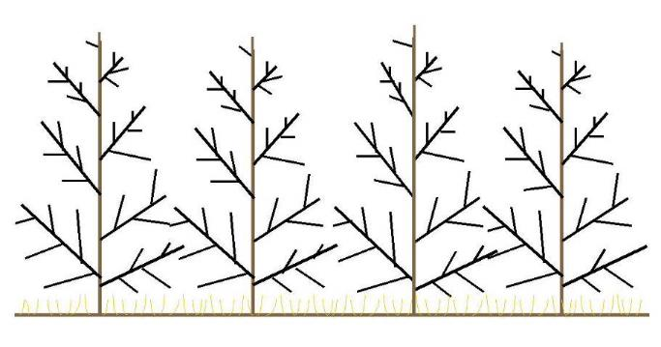
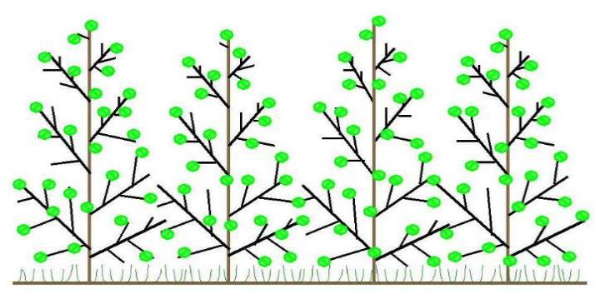
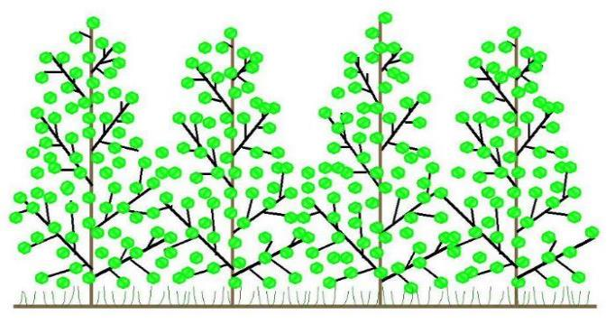
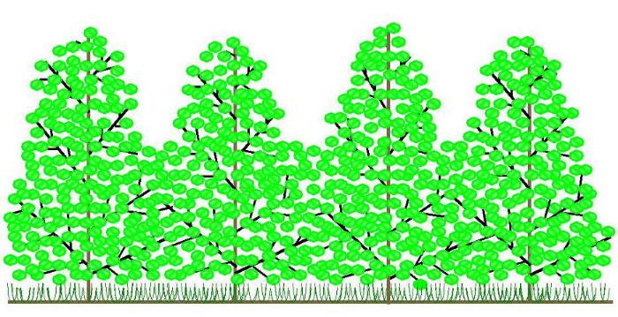
Windbreak Density
Notes:
Height and density are the two most important specifications to consider when planning for effective windbreaks.
Density - is the ratio of the solid portion of the barrier to the total area of the barrier. Wind flows through the open portions of a windbreak, thus the more solid the windbreak, the less wind passes through. By adjusting windbreak density different wind flow patterns and areas of protection are established

Slide 41
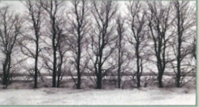
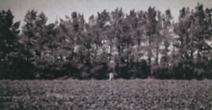
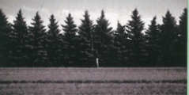
Density - Visuals
25- 50% density
50-65% density
65+% density

Slide 42
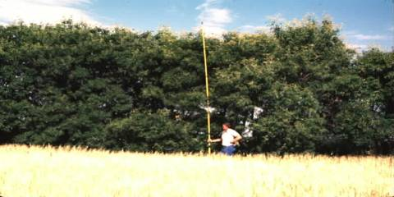
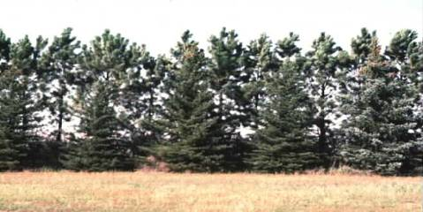
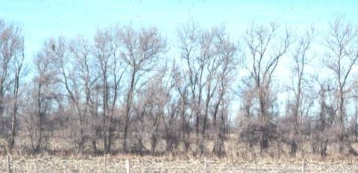
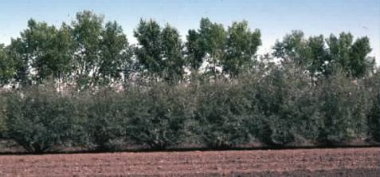
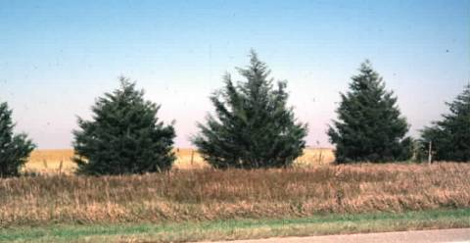
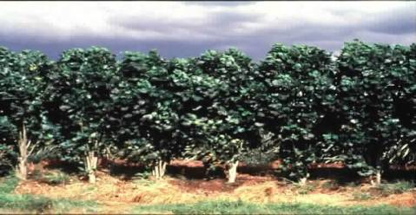
Notes:
Density - The density level is manipulated by the choice of plant materials (e.g. deciduous trees versus conifers) and the way the plants are arranged in the windbreak. By combining low growing shrubs with medium and tall deciduous trees, dense plant material is provided at three levels (low, middle and upper) of the windbreak during the growing season. However, during the winter, the density would decrease due to the loss of foliage. Consequently, a conifer component would be desirable for year-round protection.
*How would you describe the density of the bottom left picture?
For practical application purposes density is dealt with on a gross scale of low, medium and high density.
Low density is 25-40% dense
Medium density is 40-60% dense
High density is greater than 60% dense
100% density is not possible with vegetation.
Remember that density will likely vary from the bottom to the top of the windbreak.

Slide 43

Windbreak Density
Windbreak density is the percentage of the solid portion of the barrier to the total area of the barrier.
Notes:
Density - is the ratio of the solid portion of the barrier to the total area of the barrier. Wind flows through the open portions of a windbreak, thus the more solid the windbreak, the less wind passes through. By adjusting windbreak density different wind flow patterns and areas of protection are established.
Sometimes people or literature on windbreaks will refer to porosity instead of density. Remember that a 60% dense windbreak can also be considered to be 40% porous.
We usually estimate the density on an optical basis.
Q-How dense is this picture?
A-40% dense

Slide 44
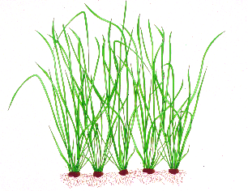
Windbreak Density
50 to 60 % density
25 to 40 % density
Notes:
Density - is the ratio of the solid portion of the barrier to the total area of the barrier. Wind flows through the open portions of a windbreak, thus the more solid the windbreak, the less wind passes through. By adjusting windbreak density different wind flow patterns and areas of protection are established

Slide 45
Continuity
Noticeable gaps can become wind tunnels
Openings for access should be staggered
WIND DIRECTION
WIND IS ACCELERATED
WIND DIRECTION
YES
NO

Slide 46
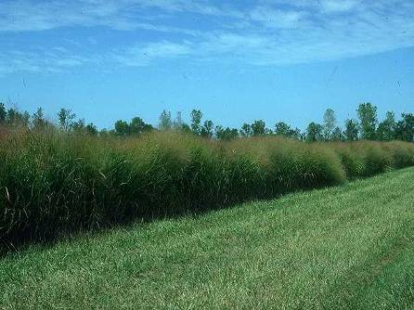
Windbreak Continuity
Gaps in the windbreak can result in damage downwind
Notes:
It is critical that the wind barriers do not have any gaps. The wind velocity through a gap can actually accelerate to 120% of open wind velocity resulting in damage as shown in the photo.
Some plants are damaged by blowing wind as well as by windborne sediment. Also, establishing seedlings in a gap can be difficult because the microenvironment is harsh.
The fewer the number of rows in the windbreak the more important it is to have a high seedling survival rate.

Slide 47
Land Preparation
If planting on new or overgrown land, clear unwanted vegetation but do not remove topsoil
If using heavy equipment, do not scrape the soil
Steeply sloping land should not be stripped of plant cover due to susceptibility to erosion
Consider using sheet mulching
Do not operate any machinery on wet soil; this can compact the soil and negatively impact plant growth and development and also increases soil erosion

Slide 48
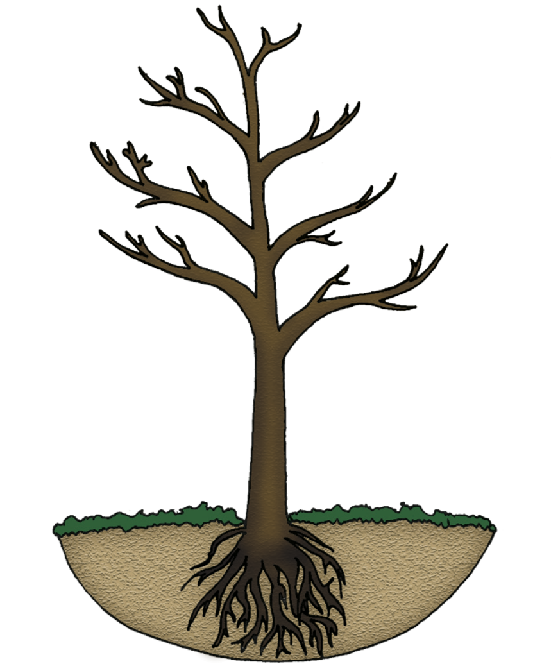
Planting and Care
Site preparation
Dig a hole at least the same depth and twice as wide as the root ball
The crown (point where root & stem meet) should be level with the ground surface

Slide 49
Planting and Care
Maintenance
Weeding
Pest & disease control
Irrigation
Fertilizing
Pruning
Mulch if possible
Replace dead plants as soon as possible
Close gaps as soon as possible

Slide 50
Supporting Government: Extension & Outreach (UOG)
Consultation/Technical Advice/Education
Appropriate/Desired species
Design
Maintenance topics
CONTACT: 735 -2080

Slide 51
Supporting Government Program: EQIP
Through participation in the NRCS EQIP farmers can:
Receive cash reimbursements for establishment costs of recommended conservation practices
Must be enrolled in program prior to implementing the practice
Must follow all program requirements
Windbreaks are one of the many recommended practices
For more information on EQIP contact your local NRCS field office at 734-2111

Slide 52
Final Pointers
Design windbreaks for the whole farm if possible
Protect from prevailing winds at the very least
Select several site-appropriate species to use
Replant early to prevent gaps
Control height and density as needed over the windbreak life.
Maintenance
Never too late to install windbreaks. Best to install at the beginning of your operation.

Slide 53



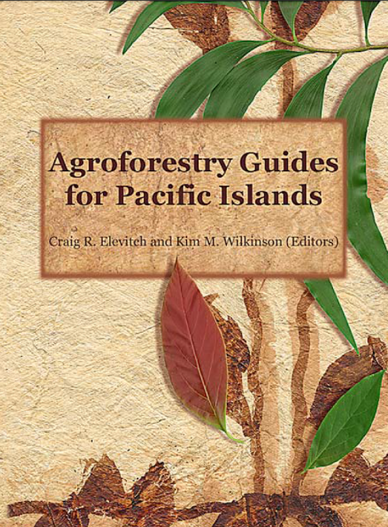
Sources of Information

